Slide 1
Physical computing from Scratch using scratchClient – Expert Control servos, LEDs and more from Scratch using RPi, Arduino, scratchClient
Hans de Jong & Gerhard Hepp
Pi And More 10
Trier – 24 June 2017

Slide 2
Strongly link the config file to the Arduino

Slide 3
The ident functionality
You created a board, but maybe you have omitted some resistors and therefore damage would occur if it were used with the wrong config file.
That is what the ident functionality is for
Configure an identity in the Arduino
Specify the identity in the config file

Slide 4
Programming the ident in the Arduino
Have the Arduino connected
Start the Arduino IDE
Go to monitor mode
Set the speed to 115200
Set the line end to newline
You can now type commands in the window.
Type:
cident:PiAndMore10
cident? (you should get the string back)
Put in the config tool the value PiAndMore10 in the field Parameter ident.pattern

Slide 5
Testing ident functionality
Start scratchClient and see that it works
Now change the value of the ident in the config file.
Hardly matters what
Start scratchClient again and see that it will be rejected

Slide 6
More about ident
The ident can in the config file be specified as a regular expression. E.g.:
A dot (.) matches any character
A star (*) repeats the previous character (0 or more times)
If you want to know more about regular expressions, see e.g. http://www.rexegg.com/regex-quickstart.html
So you could specify
PiAndMore.* and it would work when PiAndMore9, PiAndMore10 or PiAndMore100 is programmed in the ident of the Arduino
Ident is also needed to identify a specific Arduino if multiple will be connected concurrently (see next slides).

Slide 7
Controlling multiple Arduinos

Slide 8
Control multiple Arduinos
Running out of pins on one Arduino? Connect more of them!
The /dev/ttyUSBnn port in the config file will define which part of the configuration is used for which Arduino.
Using the ident functionality (see previous topic) can be used to check that the correct Arduino was connected to the intended port.
You can get the Arduinos on the correct ports by connecting them always in the same sequence.

Slide 9
Creating a config file for multiple Arduinos
First create two separate config files for each Arduino and test them out.
The config tool can only work on a single adapter at a time.
Now create a new .xml file, and
Copy in the first file completely
Take the adapter section (most of the file) of the second file and paste this after the first adapter
Adapt the USB port in one of the files (make the board that you connect last /dev/ttyUSB1.

Slide 10
Trying it out – merge and config
Take the Weekendschool board with the Duck
Test it out with the config file and the Scratch program
Merge the two files in the way described.
Make the Weekendschool board /dev/ttyUSB1.
Disconnect both boards.
Restart scratchClient with the merged file.
Connect the workshop board first. It will become /dev/ttyUSB0.
Connect the Weekendschool board second. It will become /dev/ttyUSB1.

Slide 11
Trying it out – Control from Scratch
In the Scratch program of the workshop, define these variables
Tiltservo
Panservo
Try giving them values between 0 and 100 with the slider on the variable.
Does the duck tilt and pan?

Slide 12
Making the /dev/ttyUSBnn not matter anymore
In the way described before, the Arduinos must be connected in a specific sequence
You can alternatively use a program that will
Look at the connected boards (using the ident string)
Give a selection option to start with config files for which all the boards are present.

Slide 13
Explaining the startup tool

Slide 14
Power on self test (POST)

Slide 15
Power on self test (POST)
See the Weekendschool board with the duck.
When setting up the lesson, one wants to be able to quickly see whether the board works correctly.
Also, when the boards have to be packed, the duck should bow deep to make sure it fits in the box.
Moving servos by hand is not preferred.
The scratchClient Arduino sketch has a place where you can insert your own code to realise this functionality.

Slide 16
How to do the POST?
You will need to address the pin numbers directly. You cannot make use of the config file of scratchClient.
See the Arduino sketch of the Weekendschool board.
Between the xxxx and yyyy markers
Now try on the PiAndMore board to lite 3-color LED
0.5 seconds Red
0.5 seconds Green
0.5 seconds Blue
0.5 seconds White
Load the sketch in the board and look whether it works.

Slide 17
Controlling a relay

Slide 18
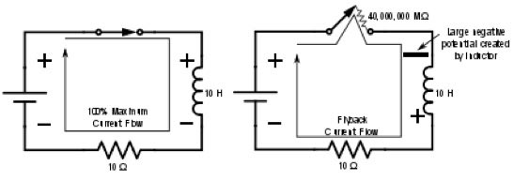
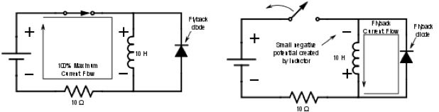
Controlling a relay
Controlling a relay like controlling a LED? NOT a good idea!
A relay has a coil that stores energy when powered.
When breaking the current flow, the voltage over the relay coil can get so high that it destroys the Arduino – and more.
At least a flyback diode should be used.

Slide 19
Other issues – and the solution
Often the current of the coil will be too high to drive directly from the Arduino
So a transistor will be needed.
Solution
Use a relay module with an opto coupler
Cost is generally not an issue. The relay module we use here is < € 1.
We only have a few relays today, so you will need to share.

Slide 20
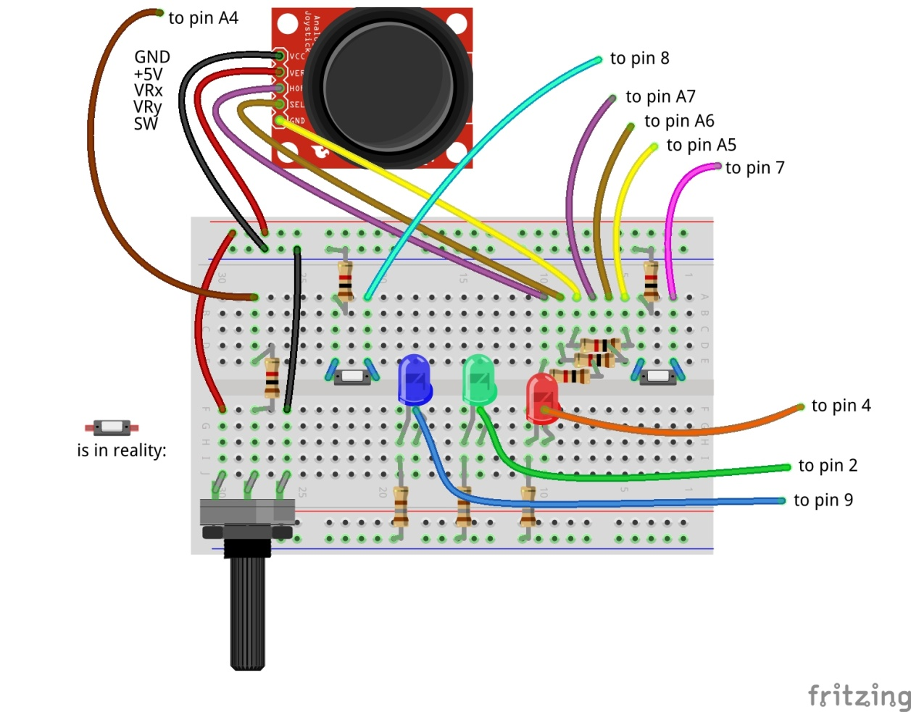
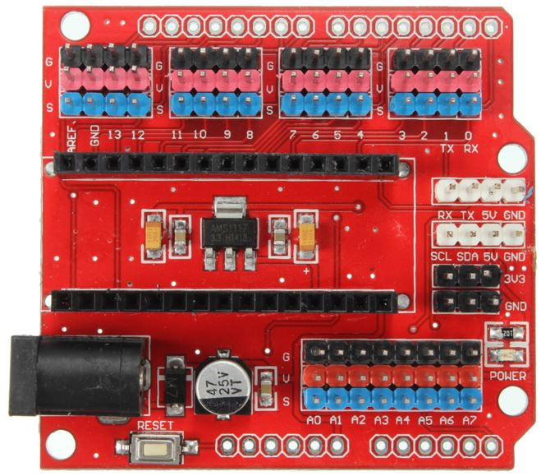

Connect the relay module to pin A2
Carefully follow the wires to connect correctly!
Don’t forget: power off and USB cable out before making changes!

Slide 21
Use a servo to press buttons on appliances

Slide 22
Safely controlling 220 Volt appliances
You can in principle use a relay to control 220 Volt appliances.
However, this is not something you want to do in a classroom situation
Alternative: use a remote control and use servos to press the buttons.
See also the next slide.

Slide 23
Controlling a camera
Use a servo to press the button of the camera
Cannot do in the workshop
See the example setup in the workshop

Slide 24
What else can scratchClient do?

Slide 25
Can scratchClient do more? Yes!
It can also let you configure and use the GPIO pins on the Raspberry Pi itself.
However be aware:
There is no analog input on Raspberry Pi.
The pins are NOT 5 Volt tolerant (max 3.3 Volt).
The max current per pin on Raspberry Pi is lower than on Arduino.
If you blow up an Arduino (clone), the cost is limited to a few euro.
A Raspberry Pi is much more expensive.
scratchClient can also control Sonic Pi for high quality audio.
There are also Arduino sketches to control LED strips (Neopixel WS2812) and to control LEGO Power.
scratchClient can work with Scratch 2.0 (soon).
scratchClient can also run on Windows and then via Arduino control peripherals.
scratchClient can work with multiple Raspberry Pi configurations in a network.

Slide 26
Take your work home

Slide 27
Do you want to take your work home?
If you brought your own USB stick, then connect it and copy the PiAndMore folder on the desktop
The rest of the material you can download from www.github.com
Take the flyer with you to remember where to find the material on github.

Slide 28
Clean up / teardown

Slide 29
Unplug and pack up
Unplug the board from USB and power it off
Please remove all components and wires from the breadboard
Remove all wires from the Arduino board.
Leave the wires on the 3 color LED
Leave the wires on the buzzer
If something is broken, please
Throw it away or hand it in (if it is unclear)
Put a note in the box that it is missing
Do not put anything that is broken back in the box
Put everything in the box. The board goes on top
Shutdown the Arduino
Let us know what you thought about this workshop, now orally or later by email
hans.piam@hanselma.nl
heppg@web.de

Slide 30
More information
All workshop material
www.github.com and search for Weekendschool or for PiAndMore
scratchClient
http://heppg.de/ikg/wordpress/?page_id=6
Scratch
https://scratch.mit.edu/
Scratch on Raspberry Pi
https://www.raspberrypi.org/forums/viewforum.php?f=77
Raspberry Pi
https://www.raspberrypi.org/
Arduino
https://www.arduino.cc/

Slide 31
End of the Advanced Workshop

Slide 32
Appendix

Slide 33
Maximum current per pin
Max output current per pin = 20 mA
Total current for the board: 1 A
Note that also the potentiometer and the joystick take power

Slide 34
Calculation of the resistors

Slide 35
Cost of the setup (1 of 2)
This is a list of the cost of the setup of the external board.
Not included is the cost of the perspex board and the nuts and bolts, which are not an absolute minimum requirement
And for which there are alternatives, e.g. use cardboard or an MDF board
All material comes from Aliexpress
Very cheap
Often no shipping costs to Europe
Takes between 2 weeks and 2 months
Or never arrives, but then money is promptly returned.
When ordering below 22 euro, no import duties and handling costs

Slide 36
Cost of the setup (2 of 2)

Slide 37
The End

